Slide 1

Introduction
Contents
Who
What
How
Coverage
Groups
Summer Tutorial in Empiricism:
Practical Help for Experimental Novices
LEvInSoN Group - Language and Cognition Department
Please take a seat – don’t get too comfy though- we’ll be putting you into groups!
Wifi: Evolang
Password: 8Autumn8

Slide 2
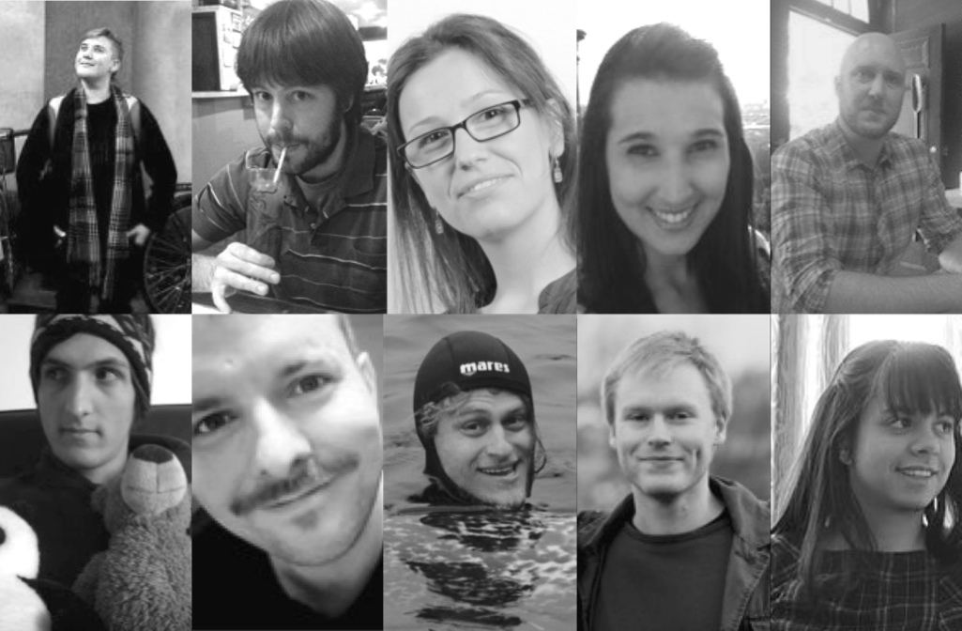
Who Are We?
Contents
Who
What
How
Coverage
Groups
The LEvInSoN Group
The group will explore the biological and cultural origins of language, and how they are linked through social interaction. The group, led by Stephen Levinson, Seán Roberts and Mark Dingemanse, will be hosted by the Language and Cognition department.

Slide 3
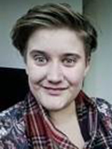





Hannah Little
Evolution of Speech
Emergence of linguistic structure (phonology, morphology and syntax) Modality affects (speech or sign)
Iconicity
Social factors
Artificial Language Experiments
Who Are We?
Contents
Who
What
How
Coverage
Groups
ai.vub.ac.be/~hannah/home.html
@hanachronism
hanachronism@gmail.com

Slide 4
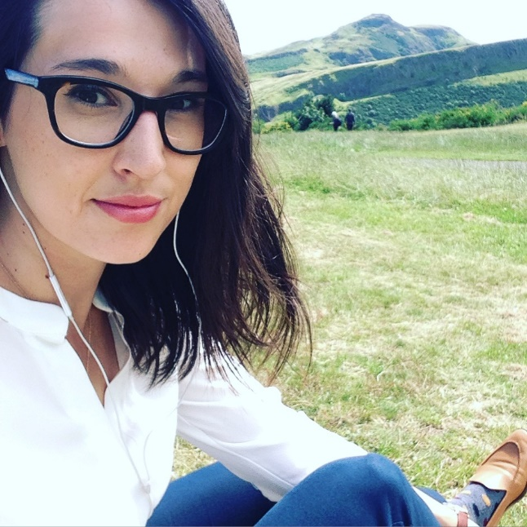

Ashley Micklos
Interaction in Language Evolution Repair and Negotiation Multimodality and Multiple Modalities Cultural Evolution of Language Conversation Analysis Language and Gender Tacos
Who Are We?
Contents
Who
What
How
Coverage
Groups
@ashleymicklos
amicklos@ucla.edu

Slide 5
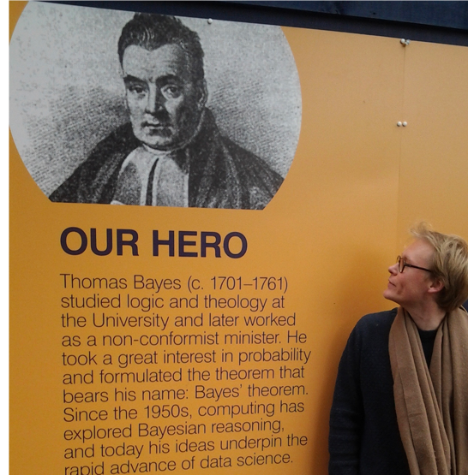
Bill Thompson
Cultural Evolution
Computational Lexical Semantics Bayesian statistics Probabilistic models of cognition
Biology – culture co-evolution
Machine Learning
Who Are We?
Contents
Who
What
How
Coverage
Groups
@billdthompson
biltho@mpi.nl

Slide 6
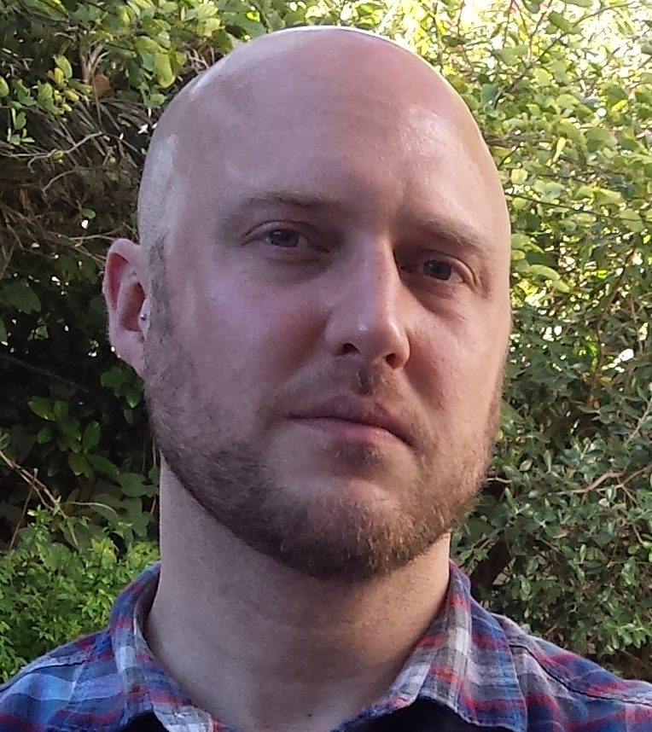
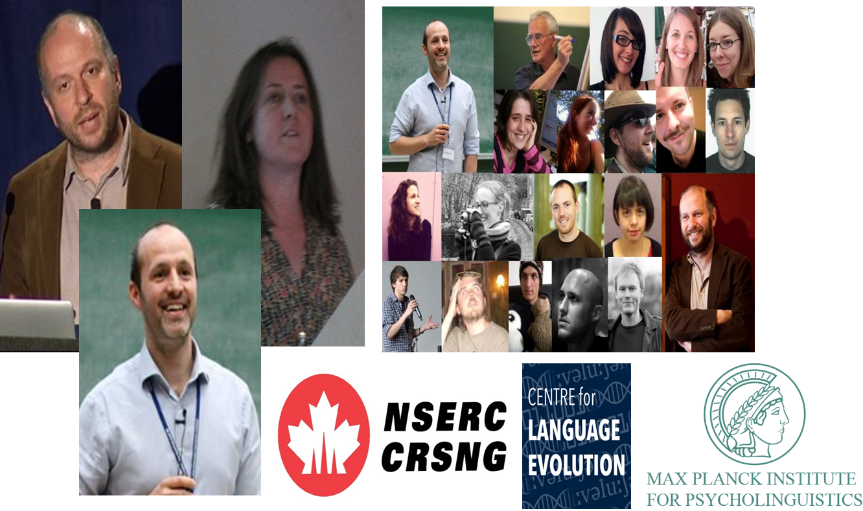

Justin Sulik
Pragmatics Novel Signalling Tasks Interaction Inference Relevance Theory Explanations
Who Are We?
Contents
Who
What
How
Coverage
Groups
@justinsulik
Justin.sulik@gmail.com

Slide 7
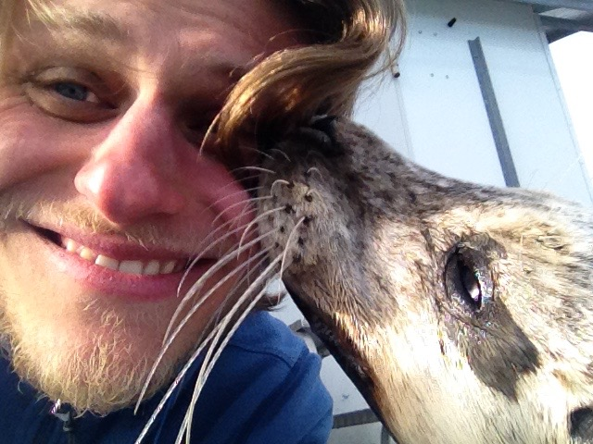


Andrea Ravignani
Animal cognition Marine mammals Vocal communication Evolution of music synchrony rhythm
Who Are We?
Contents
Who
What
How
Coverage
Groups
@AndreaRavignani
andrea.ravignani@gmail.com

Slide 8
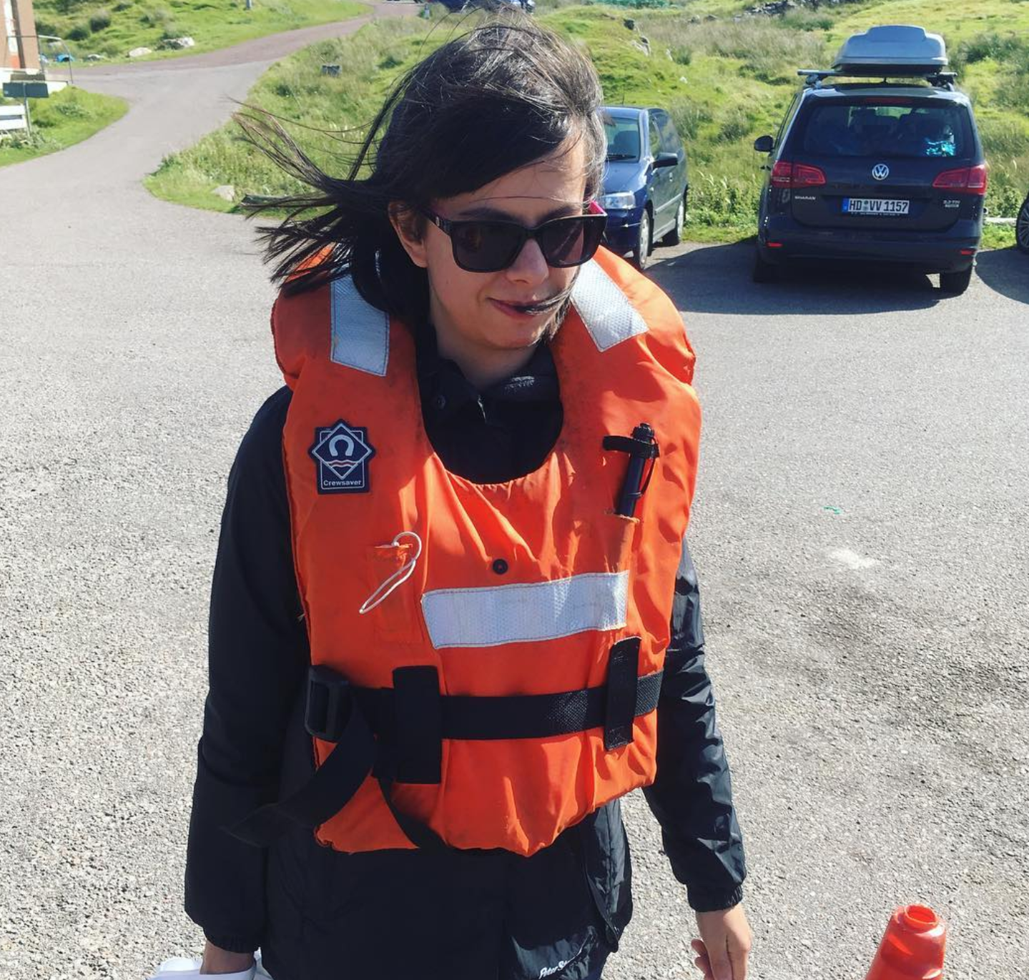

Yasamin Motamedi
Cultural Evolution of Language
Sign Language Silent Gesture Artificial Language Learning
Iconicity
Multimodality
Learning and Interaction
Who Are We?
Contents
Who
What
How
Coverage
Groups
@yaaminmoot
y.motamedi@ucl.ac.uk

Slide 9


Piera Filippi
Animal vocal interactions
Word learning Prosody Emotional communication
Sound symbolism
Who Are We?
Contents
Who
What
How
Coverage
Groups
@pierafilippi
pie.filippi@gmail.com

Slide 10
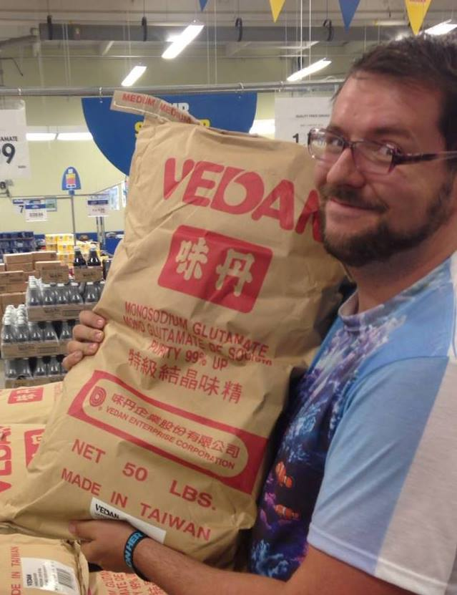
Alan Nielsen
Iconicity Perceptual and Cognitive Biases Learning Language Evolution Development Fatty Carbs Carby Fats
Who Are We?
Contents
Who
What
How
Coverage
Groups
www.languageevolution.com
@alanksnielsen
alan@languageevolution.com

Slide 11
What is this?
Contents
Who
What
How
Coverage
Groups
Summer Tutorial in Empiricism:
A synthetic view of empirical work (and collaboration)
-taking an experiment from conception to completion

Slide 12
What is this?
Contents
Who
What
How
Coverage
Groups
Goal 1- Transparency
You see science as it is done, not as it is written
-i.e. warts and all

Slide 13
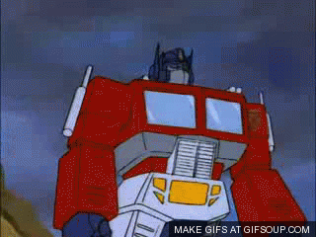
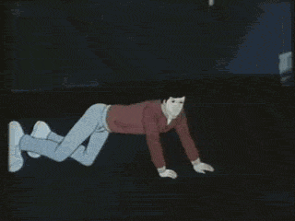
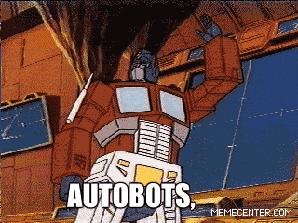
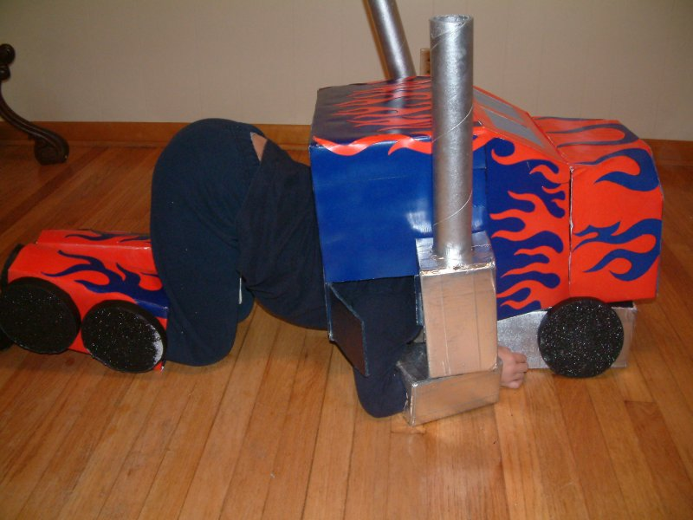
What is this?
Contents
Who
What
How
Coverage
Groups
Goal 1- Transparency

Slide 14
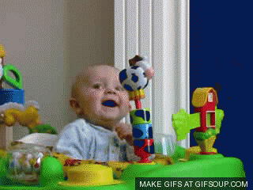
What is this?
Contents
Who
What
How
Coverage
Groups
Goal 2- Motivation
You may get scared (but hopefully not overwhelmed)

Slide 15


What is this?
Contents
Who
What
How
Coverage
Groups
Goal 3- Learning
You are amazed. You learn.
Not all of the technical details
-Tools to know what is possible
-Lots of supplementary information

Slide 16
How Will this Work?
Contents
Who
What
How
Coverage
Groups
General Structure of Lessons
1- Basic Examples
2- Time to play with examples
3- Actual code for data handling/experiment/analysis (or at least portions thereof)
4- More time to tinker with code (and produce outputs)

Slide 17
What Will I Learn?
What Will We Cover?
Contents
Who
What
How
Coverage
Groups
A Disclaimer:
You will not leave this Summer School with the ability to put together the Experiment and all analyses that we will be showing you
1- Experience
2- Collaboration
3- Amount of Work

Slide 18
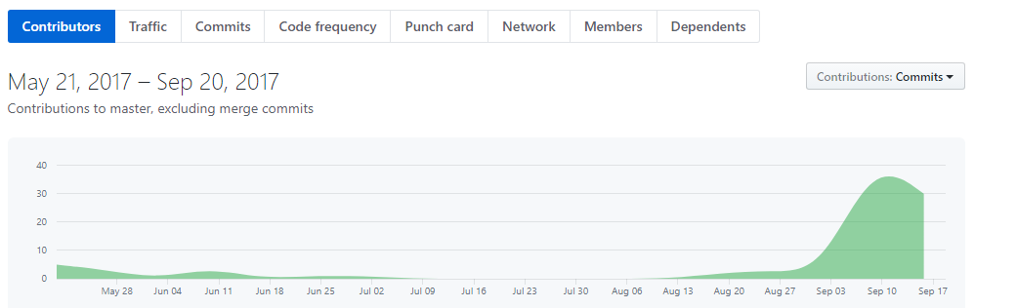
What Will We Cover?
Contents
Who
What
How
Coverage
Groups
Collaboration:

Slide 19
What Will We Cover?
Contents
Who
What
How
Coverage
Groups
Experiment Design
How to think scientifically
How to align design with statistical analyses
How to create well-balanced samples

Slide 20
What Will We Cover?
Contents
Who
What
How
Coverage
Groups
Experiment Deployment
How to create experimental interfaces in Javascript
How to manage participants online and collect data quickly

Slide 21
What Will We Cover?
Contents
Who
What
How
Coverage
Groups
Analysis
How to handle and sanitize data
Basic descriptive statistics
LMER in R
Clustering and/or Factor Analysis in R
Producing meaningful and informative visualisations

Slide 22
What Will We Cover?
Contents
Who
What
How
Coverage
Groups
Computational Approaches
How to simulate data
How to impute unseen values
Agent-based models

Slide 23
How Did You Get Here?
Contents
Who
What
How
Coverage
Groups
A Diversity of Students
Different Departments Different Universities Different Backgrounds
2 BSc Students
3 MA Students
20 PhD Students
2 Postdocs

Slide 24
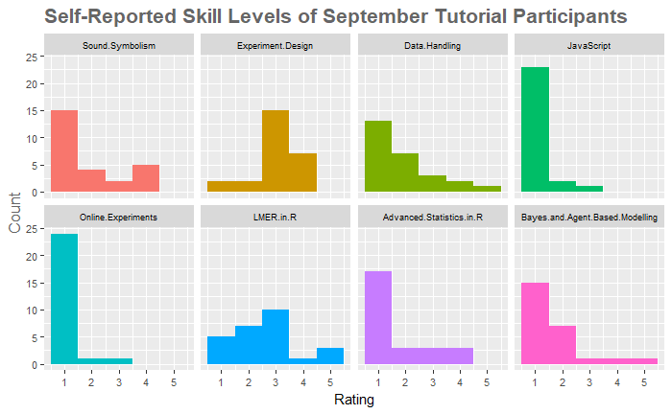
How Did You Get Here?
A Diversity of Students

Slide 25
How Did You Get Here?
Making Groups
1- Familiarity with R
2- Experiment Design and Data Handling
3- Bayes
4- Knowledge of Sound-Symbolism
5- Home Institution and Gender

Slide 26
How Did You Get Here?
Making Groups

Slide 27
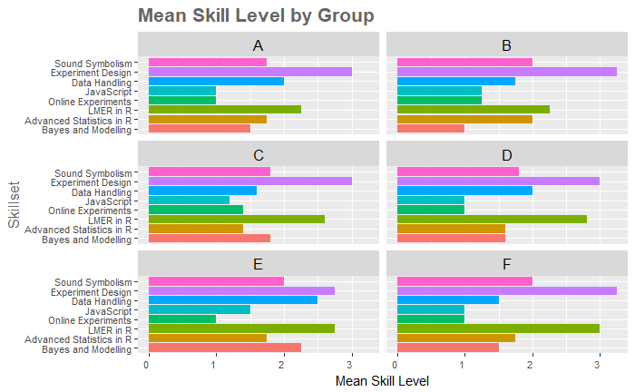
How Did You Get Here?
Making Groups

Slide 28
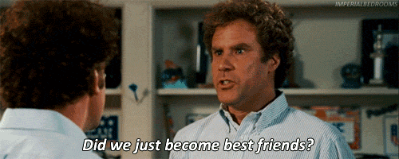

Meet Each Other
Go on… do it!
And also….

Slide 29
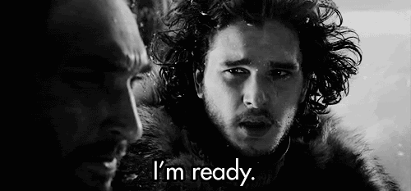
Preparation
Anacondas (2.7) - https://www.anaconda.com/download/
Atom – https://atom.io/
GitHub Desktop – https://desktop.github.com/
GitHub Repo - https://github.com/hecticdialectic/ste-phen

Slide 30
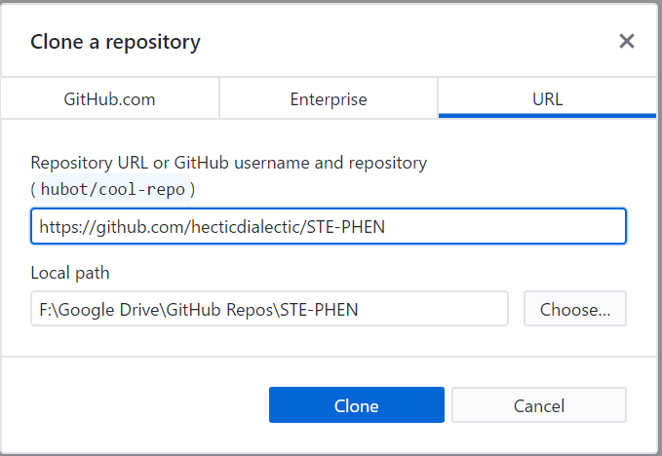
Preparation

